Slide 1

Development of control software for time-lapse microscopy
Dzmitry Lahoda
LEADER OF THE PROJECT: JAN VANĚK
Bioengineering group of Dalibor Štys
Notes:
1

Slide 2
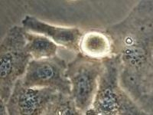
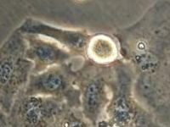
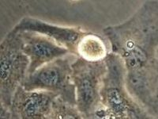
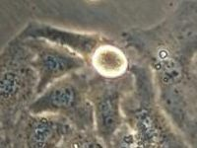
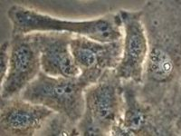
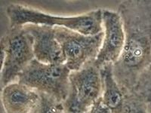
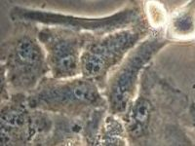
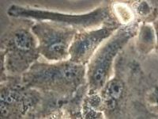

Introduction
Time-lapse microscopy
00.00
00.02
00.04
00.08
…
00.50
00.52
01.38
01.40
…
Notes:
2

Slide 3
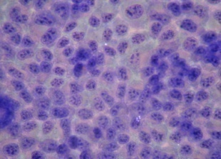
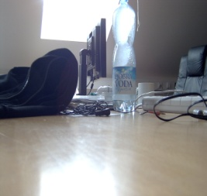
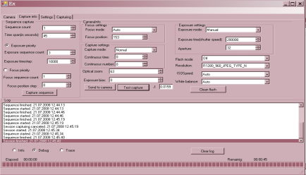
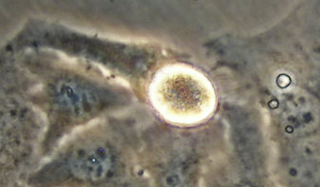
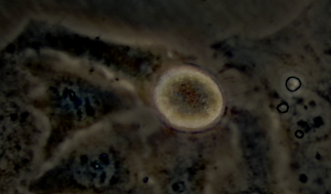
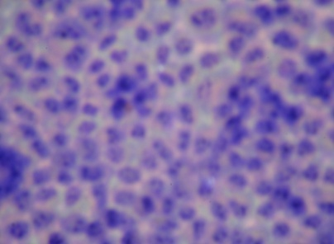
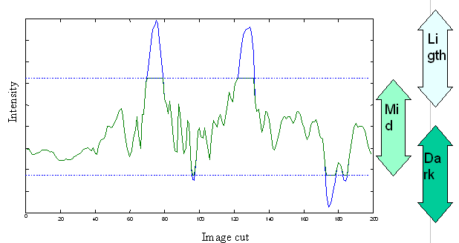
Goal of work
halo effect
Provide possibility to get maximum available information from sequence of photos using different camera setups.
Notes:
3
Focus- the point where light rays originating from a point on the object converge.

Slide 4
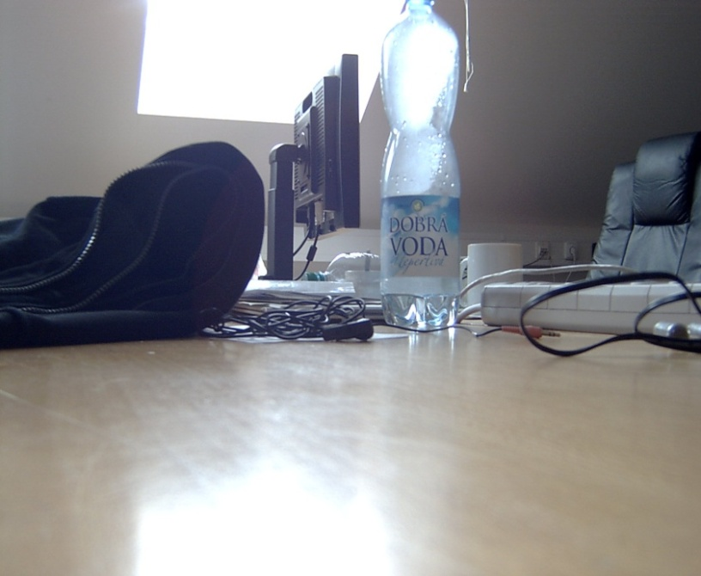
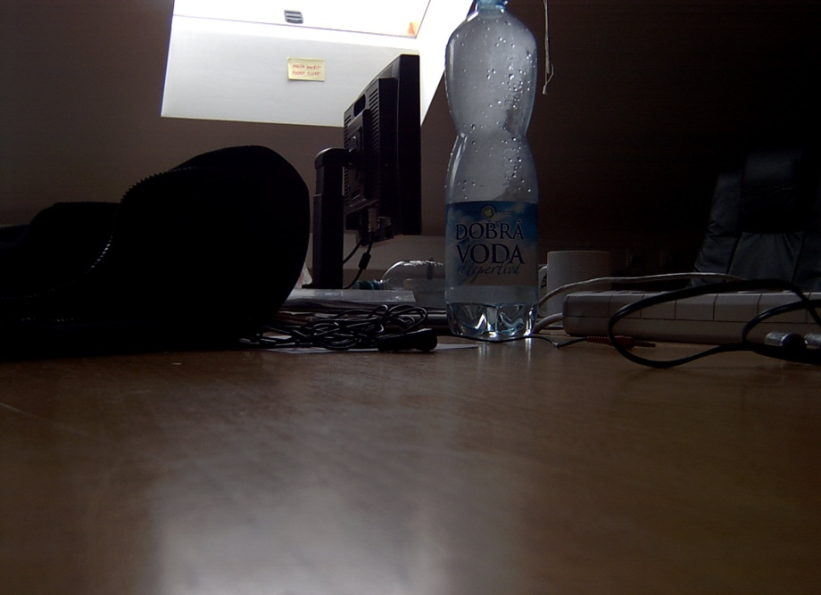
Setup: shutter speed
Good
Bad
Slow speed
Fast speed
Notes:
4
Focus- the point where light rays originating from a point on the object converge.

Slide 5
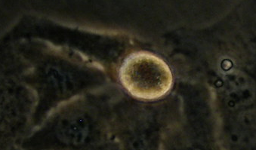
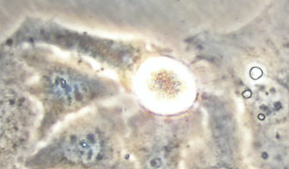
Intensity
of light
Notes:
5
Focus- the point where light rays originating from a point on the object converge.

Slide 6

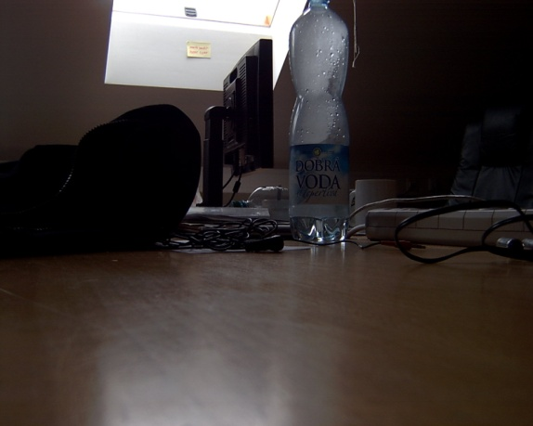
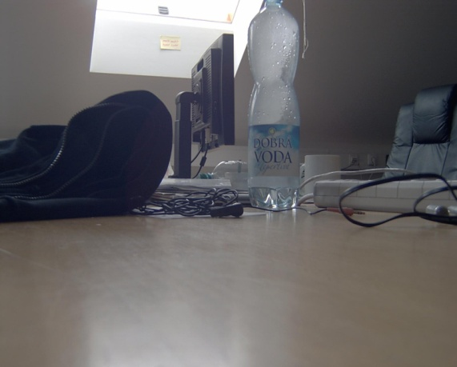
Shutter speed: mix
Notes:
6
Focus- the point where light rays originating from a point on the object converge.

Slide 7
Cell mix
Notes:
7

Slide 8
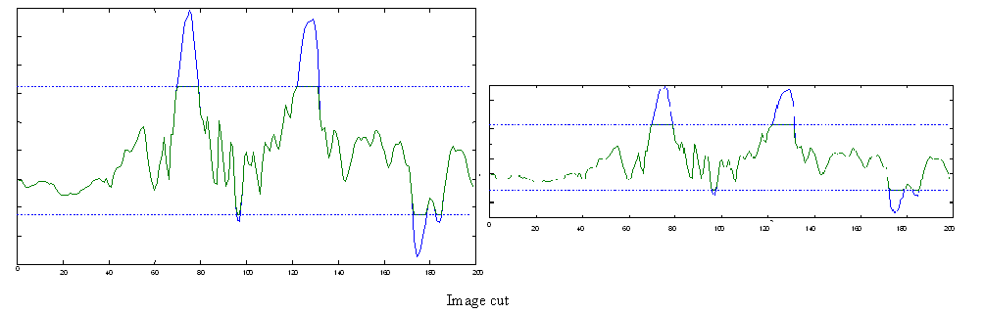
Cell mix
Compressed
Notes:
8
Focus- the point where light rays originating from a point on the object converge.

Slide 9
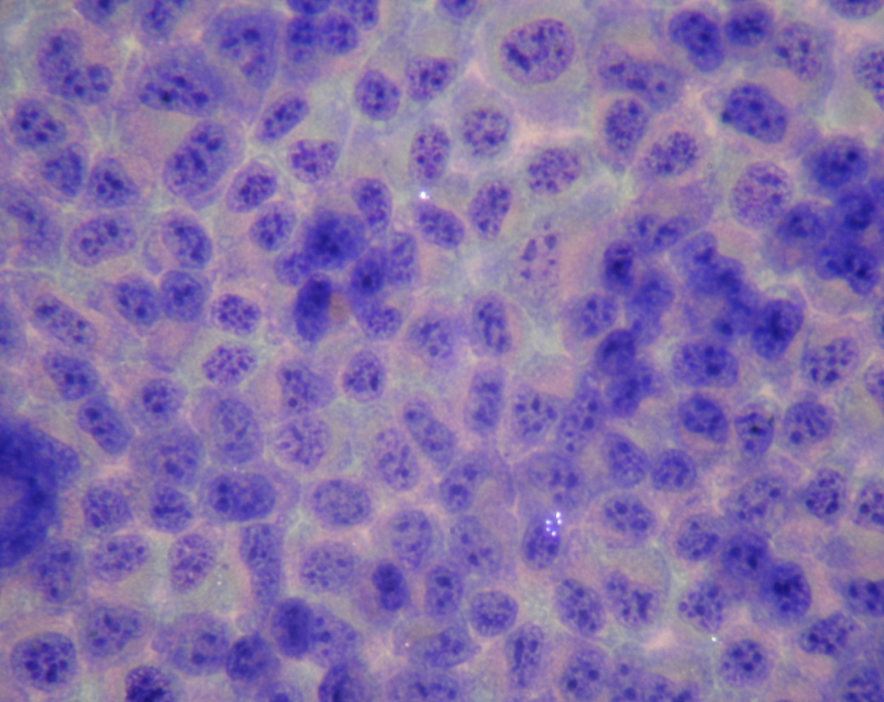
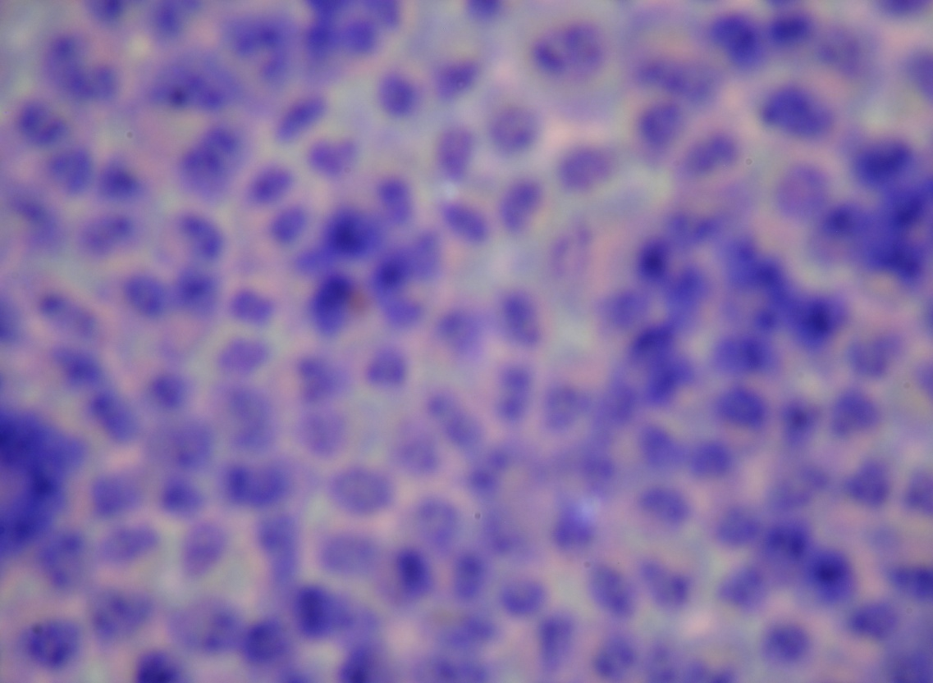
Setup: Focus
In focus
Out of focus
Notes:
9
Focus- the point where light rays originating from a point on the object converge.

Slide 10
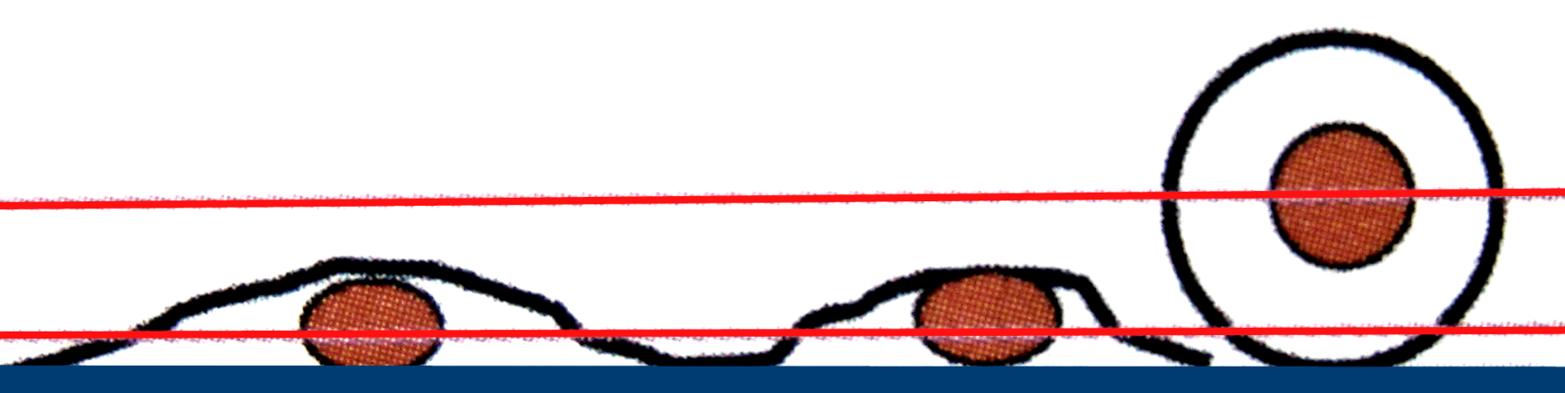
3rd dimension
Focus position
178
171
Notes:
10
Focus- the point where light rays originating from a point on the object converge.

Slide 11
Focus
Which is better?
1
2
Notes:
11
Focus- the point where light rays originating from a point on the object converge.

Slide 12
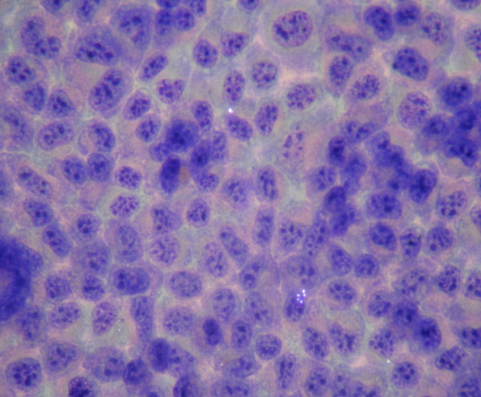
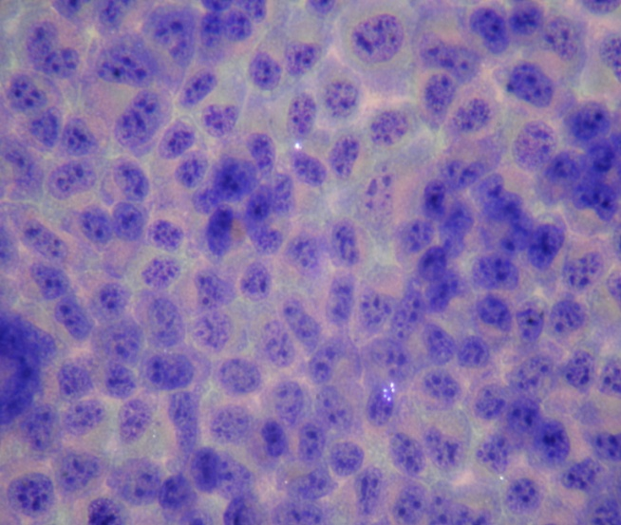
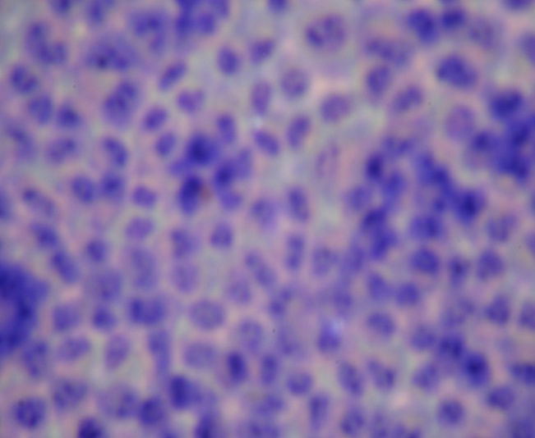

Contrast measurement
some numbers
0,9801
0,9512
0,8488
Best one
Better
Bad focus
Notes:
12
Focus- the point where light rays originating from a point on the object converge.

Slide 13
Software
http://www.promicra.com
http://www.oko-lab.com
http://www.pinetreecomputing.com/camctl.asp
http://www.sabsik.com
…
There is no software decision wich supports sequential capturing with different user defined setups on Olympus cameras
Notes:
13
Focus- the point where light rays originating from a point on the object converge.

Slide 14

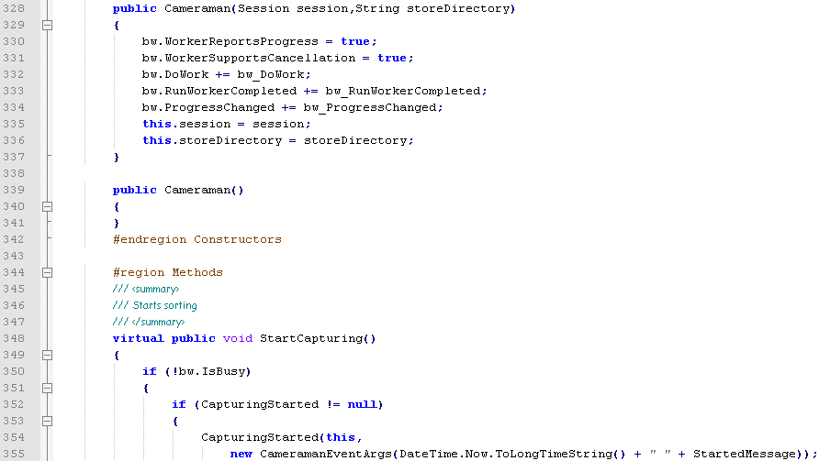
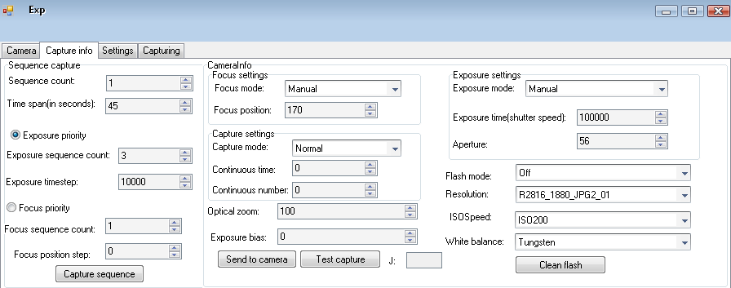
: settings
3. Sequence
2. Focus
1. Shutter speed
0. some settings
GO!
Notes:
14
Focus- the point where light rays originating from a point on the object converge.

Slide 15
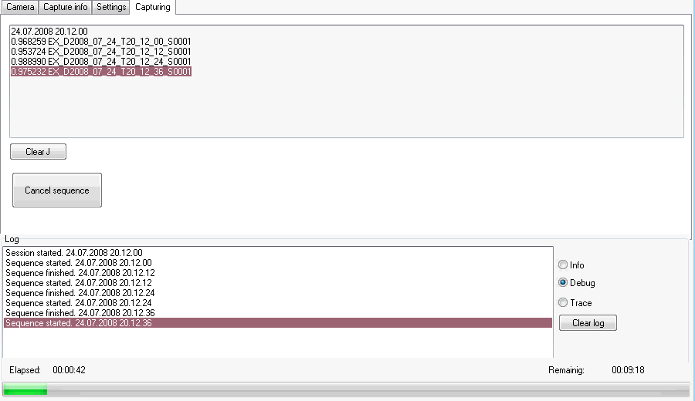
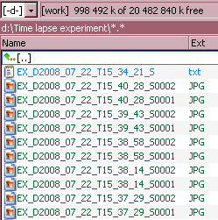




: capturing
Real-time
contrast measurement
Good for automatic analyzing
Information
Progress
Used:
Notes:
15
Focus- the point where light rays originating from a point on the object converge.

Slide 16

Conclusion
Problem: low contrast pictures
Solution: new software for taking several pictures with different setups
Problem: focus quality control
Solution: contrast measurement algorithm
successfully tested

Slide 17
Thank you for attention
Development of control software for time-lapse microscopy

Slide 18
